Slide 1




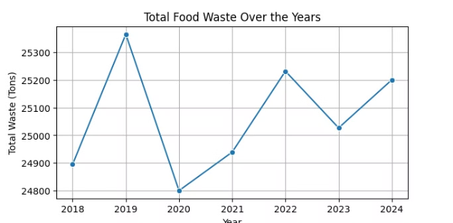
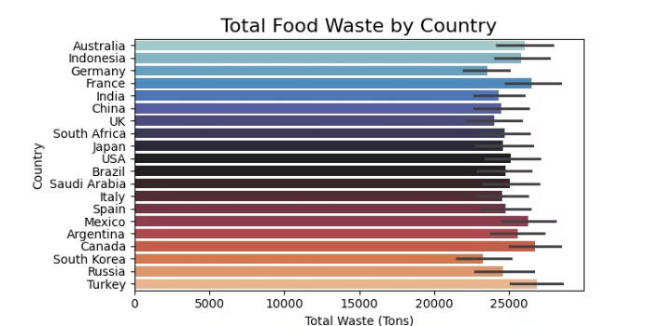
Food Wastage Analysis:
Data-Driven Approaches to a Global Challenge
Food wastage represents a critical global challenge, with approximately one-third of all food produced going to waste. This wastage impacts our economy, environment, and food security on a global scale.
This presentation explores data-driven approaches to understanding and addressing food waste through machine learning and statistical analysis. By examining patterns across countries, food categories, and consumption behaviors, we aim to provide actionable insights for businesses, policymakers, and sustainability professionals.
AM
by Annette Mehrvarz - April 2025

Slide 2

The Project Overview:
EDA
Categoric and Numeric Features
Feature Engineering
Data Standardization and Normalization
Data Visualization
ML Modelling and Evaluation

Slide 3
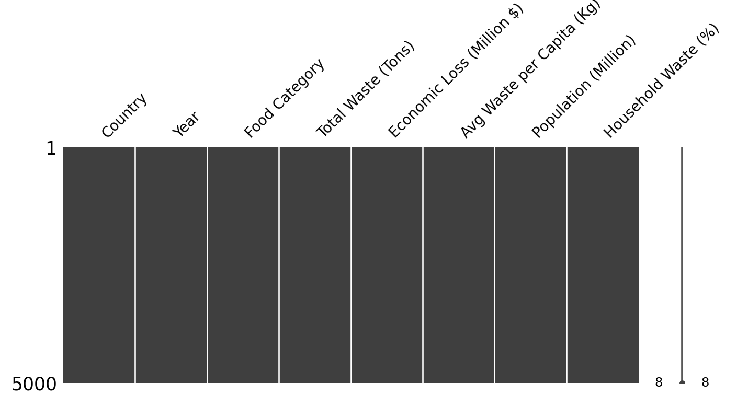
ONS Data Source:
https://www.ons.gov.uk/search?q=household+food+waste&filter=time_series&filter=datasets&filter=user_requested_data&sort=relevance
Natural Earth Data: GeoPandas
https://www.naturalearthdata.com/downloads/110m-cultural-vectors
Statista:
https://www.statista.com/chart/31072/food-wasted-per-capita-in-european-countries
Supply Chain: Some 40% of household food wastage is through supply chain
Feature engineering transforms our raw data into more predictive variables. By creating these derived features, we enhance the predictive power of our models and gain deeper insights into the underlying factors driving food wastage patterns globally.

Slide 4

Understanding the Scale of Global Food Waste
33%
5,000
8
Global Food Waste
Data Points
Key Features
Of all food produced globally
Observations across countries
Dimensions in our dataset
Our dataset contains 5,000 observations across multiple countries and years, providing a comprehensive view of global food wastage patterns. By analyzing metrics such as total waste tonnage, economic losses in millions of dollars, and per capita waste, we can identify critical areas for intervention.
The dataset's eight features allow us to explore relationships between population size, household waste percentages, and economic impact across different food categories and regions.

Slide 5
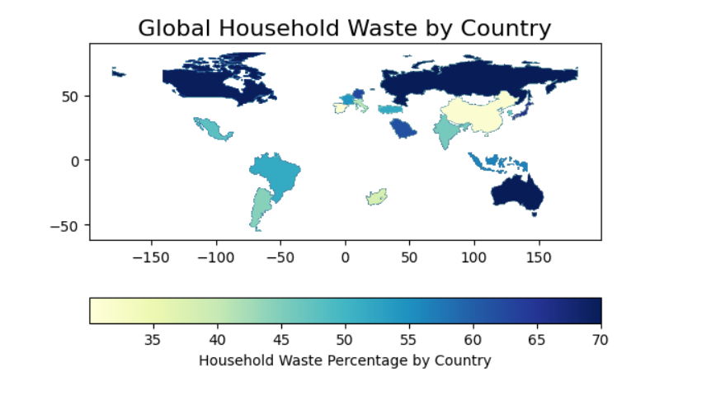
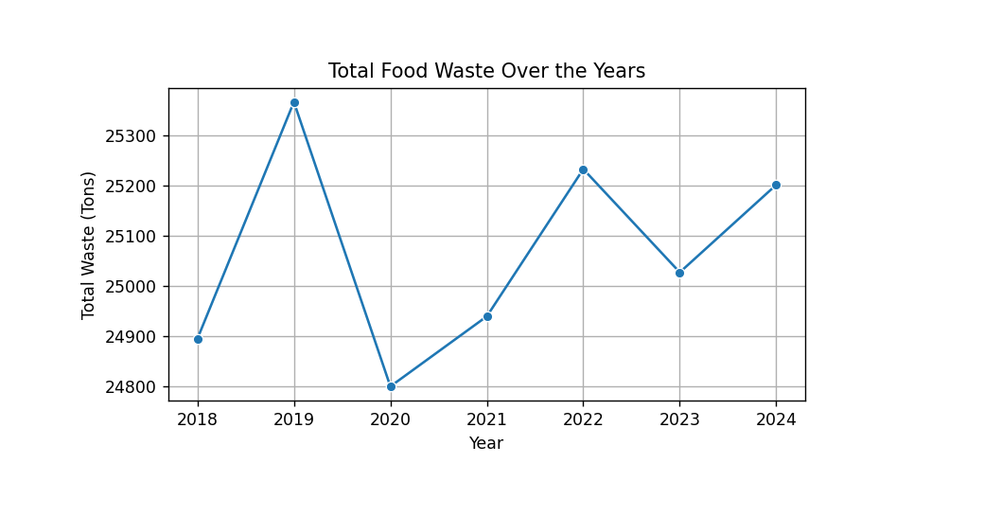
Advanced Data Visualization Techniques
Geospatial Mapping
Time Series Decomposition
Visualizing waste patterns on interactive maps to identify regional hotspots and spatial correlations with environmental or economic factors.
Breaking down waste trends into seasonal, trend, and residual components to understand cyclical patterns and long-term changes.
These visualizations help policymakers target specific regions for intervention programs.
Useful for forecasting future waste levels and measuring the impact of intervention programs.

Slide 6
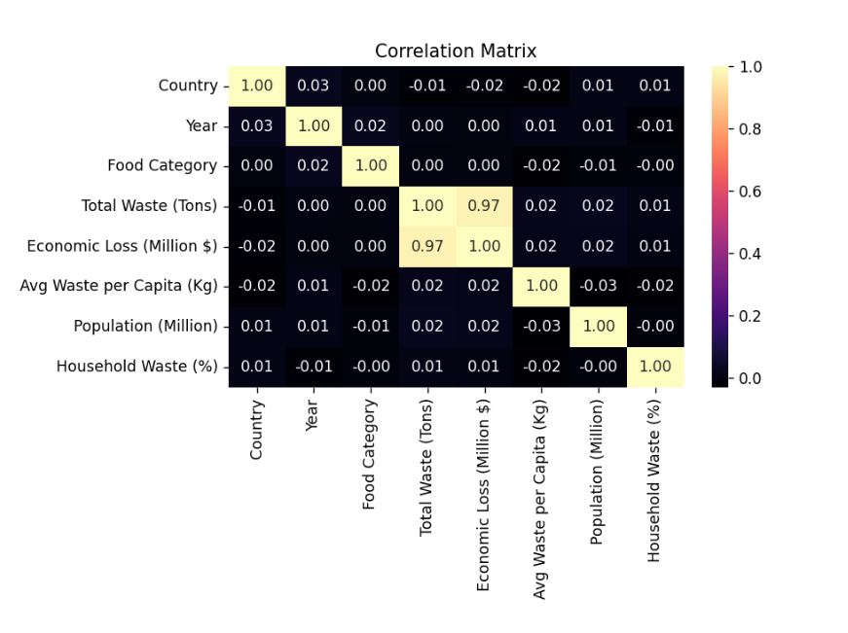
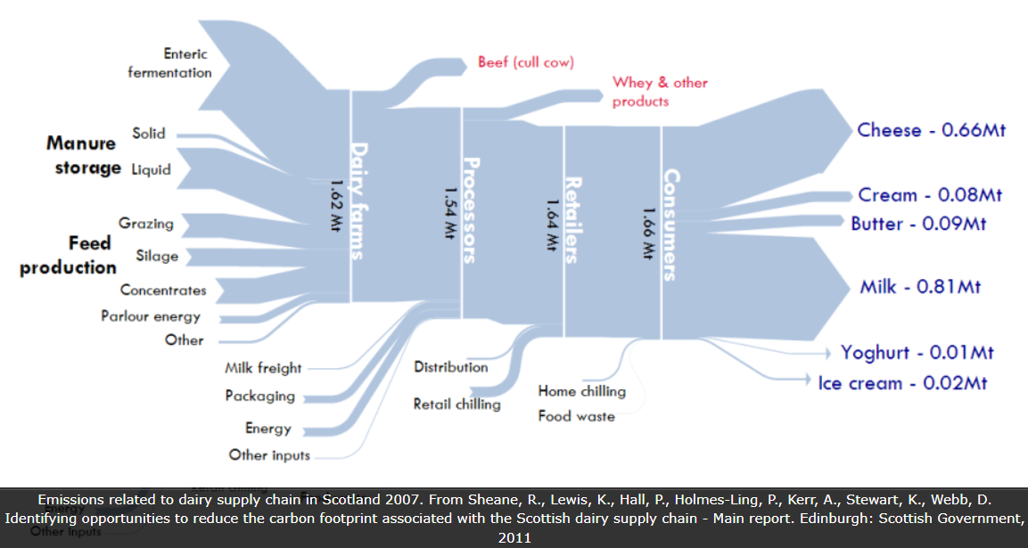
Advanced Data Visualization Techniques
Correlation Heatmaps
Sankey Diagrams
Identifying relationships between features through color-coded matrices, revealing which factors are most strongly associated with high waste levels.
Tracking the flow of food waste through different stages of the supply chain, highlighting where the greatest losses occur.
Helps prioritize which variables to include in predictive models.
Essential for identifying critical intervention points for waste reduction.
Effective data visualization transforms complex patterns into intuitive insights. By applying these advanced visualization techniques to our food waste dataset, we make patterns more accessible to stakeholders and decision-makers from diverse backgrounds.

Slide 7
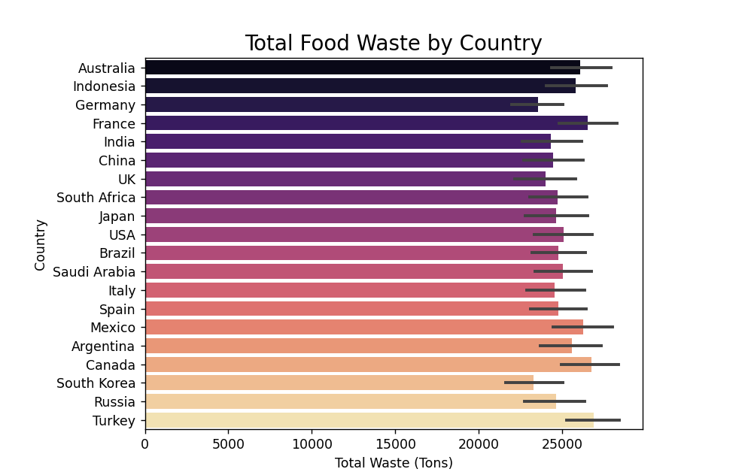
Exploratory Data Analysis: Key Dimensions
Geographic Analysis
Examining waste patterns across different countries to identify regional variations and cultural factors influencing food waste generation.
This dimension allows us to compare developed versus developing nations and understand how economic development correlates with wastage patterns.
Our exploratory data analysis focuses on understanding relationships between key variables. By examining these dimensions together, we can identify critical patterns and potential intervention points across the food supply chain.

Slide 8
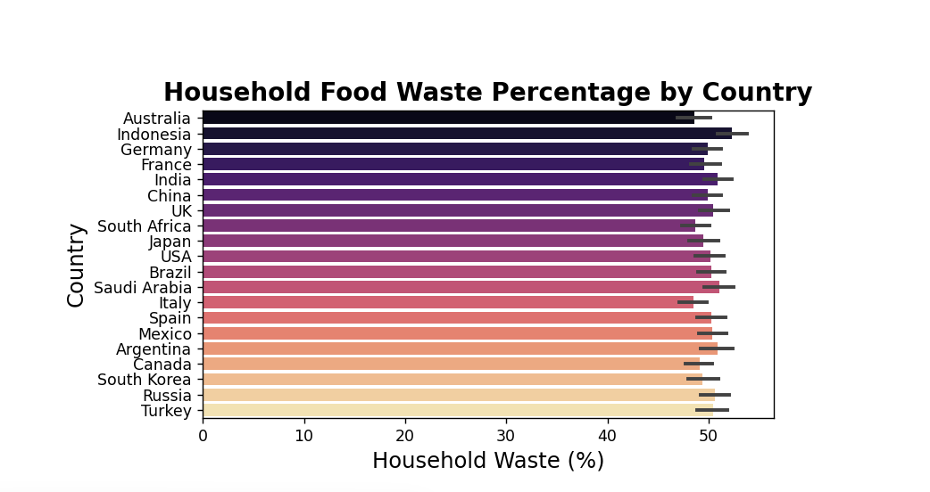
Exploratory Data Analysis: Key Dimensions
Temporal Trends
Analyzing how food waste has changed over time, identifying seasonal patterns and long-term trends that may be influenced by policy changes, economic conditions, or awareness campaigns.

Slide 9
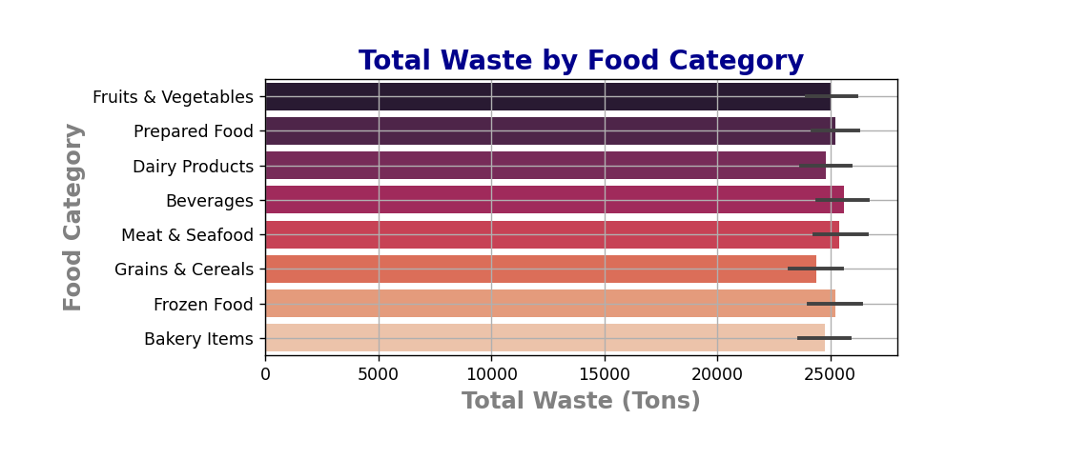
Exploratory Data Analysis: Key Dimensions
Food Category Analysis
Breaking down waste by food type to identify which categories experience the highest wastage rates and economic losses, allowing for targeted interventions in specific food supply chains.

Slide 10
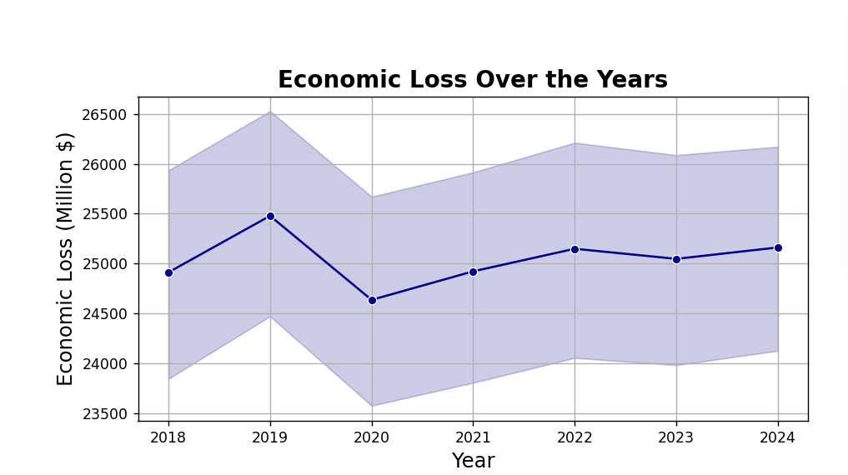
Feature Engineering for Waste Prediction
Derived Economic Metrics
Creating efficiency metrics like "Economic Loss per Ton" to better understand the financial impact of different types of food waste across regions.

Slide 11
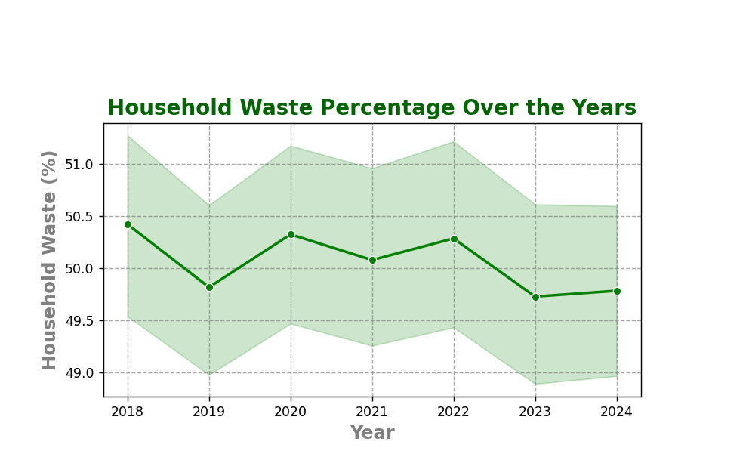
Feature Engineering for Waste Prediction
Temporal Features
Extracting seasonal components, year-over-year growth rates, and cyclical patterns to capture changing waste dynamics over time.

Slide 12
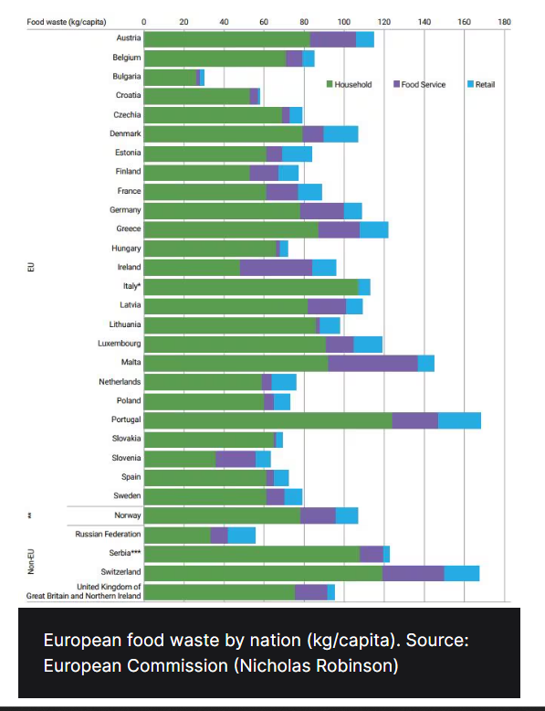
Feature Engineering for Waste Prediction
Geographic Indicators
Developing region-specific variables that account for economic development status, climate zones, and cultural factors that may influence food consumption and waste.

Slide 13
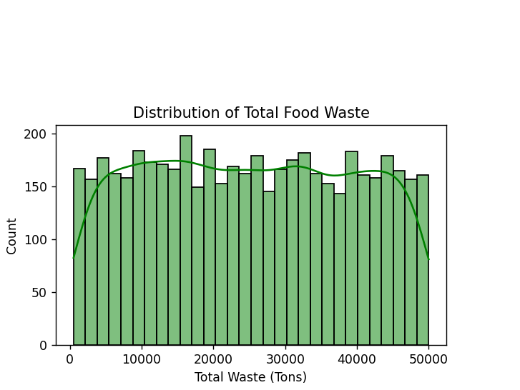
Feature Engineering for Waste Prediction
Population-Adjusted Metrics
Creating per-capita and density-adjusted waste metrics to enable more meaningful comparisons across countries with vastly different population sizes.

Slide 14








Data Standardization and Normalization Techniques
Standard Scaling
Min-Max Normalization
Transforming features to have zero mean and unit variance, crucial for machine learning algorithms sensitive to feature scales.
Scaling features to a fixed range (0-1), preserving the shape of the original distribution while limiting the influence of outliers.
Variable Transformation
Outlier Treatment
Applying logarithmic, square root, or other transformations to handle skewed distributions common in food waste data.
Identifying and addressing extreme values that may represent data entry errors or exceptional cases affecting model performance.
Proper data standardization is essential for meaningful analysis and accurate model building. Our approach ensures that variables with different scales can be compared fairly, preventing features with larger ranges from dominating the analysis.
Each standardization technique serves a specific purpose in our analytical pipeline, applied based on the distribution characteristics of individual features and requirements of our modeling approaches.

Slide 15
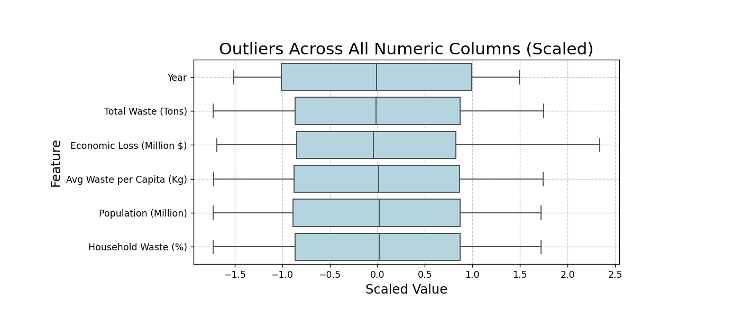

Slide 16
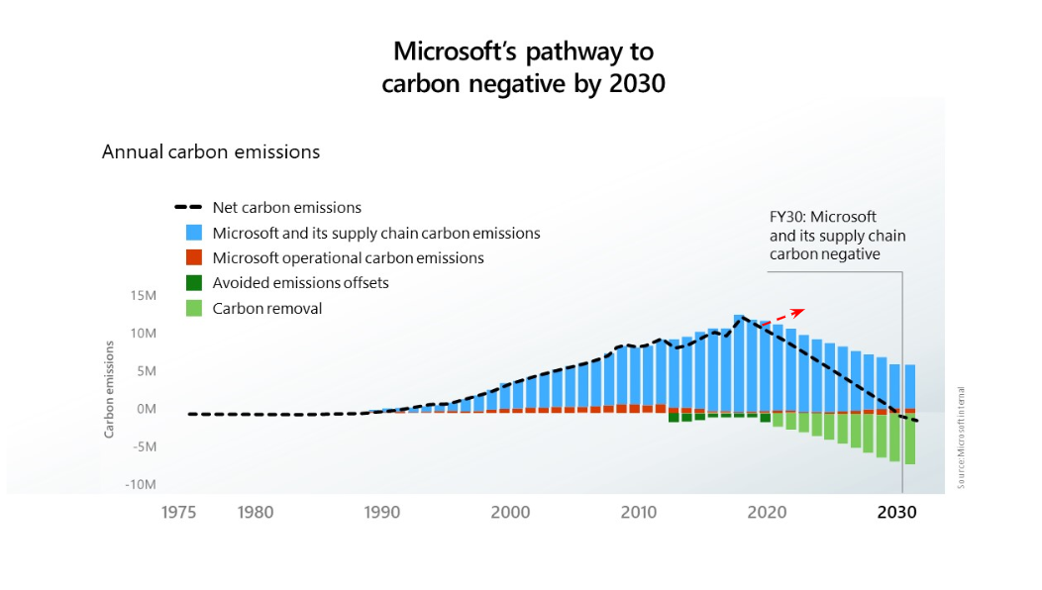

Slide 17




Machine Learning Models for Waste Prediction
Regression Models
Linear and polynomial regression to predict waste quantities based on economic and demographic factors, providing baseline predictions and identifying key drivers.
Decision Tree Ensembles
Random Forests and Gradient Boosting models to capture complex non-linear relationships between features and food waste outcomes, offering robust predictions across diverse scenarios.
Neural Networks
Deep learning approaches for capturing intricate patterns in time series data, particularly useful for forecasting future waste trends across different countries and food categories.
Clustering Algorithms
Unsupervised learning to identify natural groupings of countries or regions with similar waste profiles, enabling targeted policy approaches for each cluster.
Our modeling approach deployed a set of 2 regression algorithms (Random Forest and XGBoost) in this study to capture different aspects of food waste patterns, both displaying good close results. By comparing multiple models, we can identify the most accurate predictors and understand the underlying factors driving waste generation.
Each model undergoes rigorous evaluation using cross-validation techniques to ensure reliable performance across different countries and time periods.

Slide 18
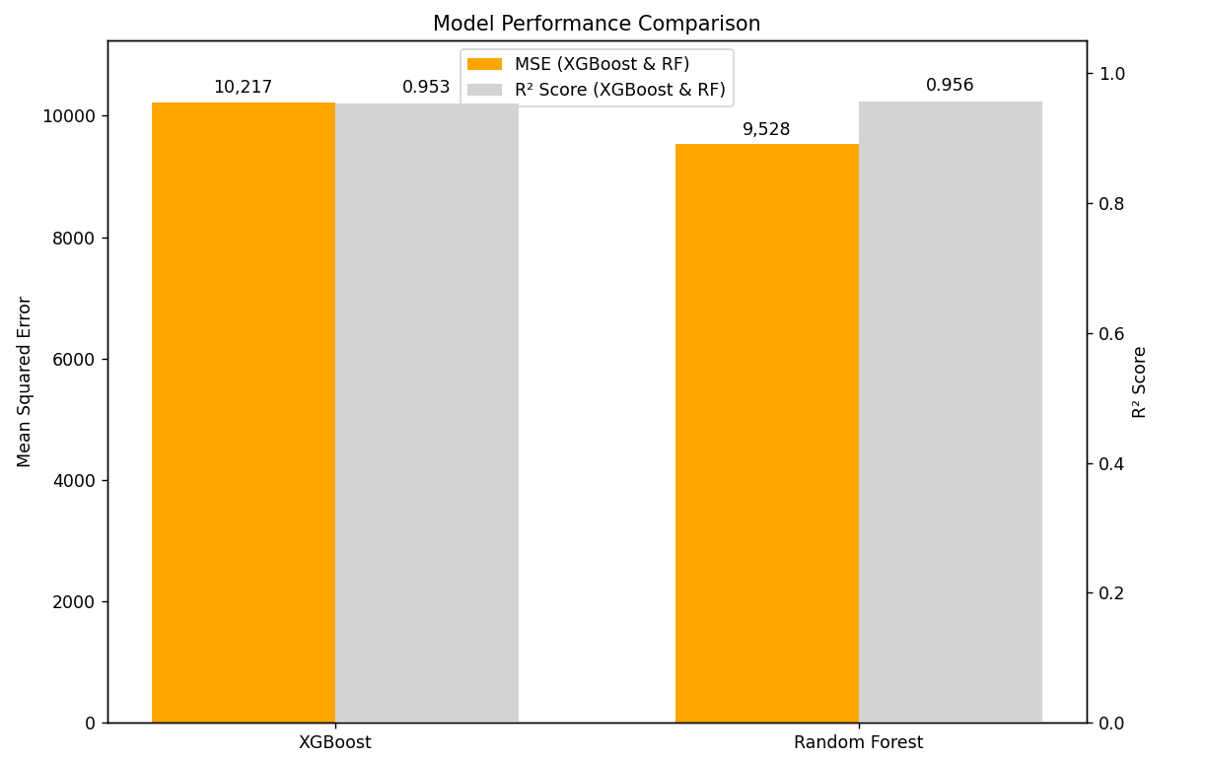
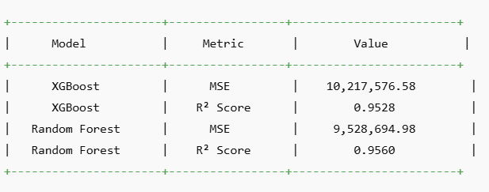

Slide 19






From Insights to Action: Driving Sustainable Change
Policy Recommendations
Data-driven policy frameworks based on predictive insights
Supply Chain Optimization
Targeted interventions at critical waste points
Consumer Behavior Change
Educational campaigns backed by household waste data
Our data analysis journey culminates in actionable strategies for meaningful waste reduction. By translating complex statistical findings into clear recommendations, our analysis provide stakeholders with practical tools to address food wastage at multiple levels.
The insights from our machine learning models enable targeted interventions along the entire food supply chain - from production and distribution to retail and household consumption. This multifaceted approach ensures that solutions address the specific drivers of waste identified through our analysis.
Through continuous monitoring and model refinement, we can track the effectiveness of these interventions and adapt strategies over time, creating a sustainable framework for ongoing waste reduction.

